Slide 1
ASP.NET MVC

Slide 2
MVC Model
MVC Model defines the web application with 3 logic layers
The business layer (Model logic)
The display layer (View logic)
The input control (Controller logic)

Slide 3
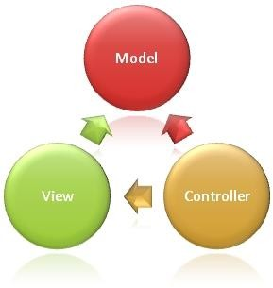
MVC Model

Slide 4
Role of Model, View and Controller
Model
Handles the logic for application data
Retrieves data from the database
View
Handles display of data . Views are created mostly from model data
Controller
Handles User interaction. Read from a View, Control user input and send input data to the model.

Slide 5
Separation Of Concerns

Slide 6
Separation Of Concerns
The process of breaking a computer program into distinct features that overlap in functionality as little as possible
Views are presentation form of applications and needs to have no knowledge of the actions coming from Controllers
The Models are business entities
The sole purpose of the Controller is to handle request and it can be independent of the Views and Models

Slide 7
MVC When to Use
High level of control over generated HTML
Separation of Concerns
Highly Testable code base
Suitable for applications done by a large team of developers

Slide 8
MVC Benefits
Easier to manage
No View State and suitable for applications with many forms
Suitable for Test driven developments

Slide 9
Open Source Release
Since May 2012 ASP.Net MVC is a open source project and you can contribute back to the repository

Slide 10
Convention Over Configuration
The three directories that make the application work
Model
View
Controller
Are there by default(convention)

Slide 11
Convention Over Configuration
The Controllers is appended to the name of the Controller
The Views that are tied to Controllers reside in a directory under Views with the Controller name

